Slide 1
Software Maintenance, Legacy Systems, and Technical Debt
COMP6100001 - Software engineering
Session 21
Kenny Jingga, S.Kom., M.T.

Slide 2
Session 21 – Software Maintenance, Legacy Systems, and Technical Debt
Learning objectives
At the end of this session, students will be expected to be able to:
Explain why maintenance dominates the lifecycle
Differentiate types of maintenance
Analyze legacy system challenges
Explain technical debt and its impact
Propose strategies to manage technical debt

Slide 3
Session 21 – Software Maintenance, Legacy Systems, and Technical Debt
Content outline
Software maintenance fundamentals
Types of maintenance
Legacy systems challenges
Technical debt concepts
Strategies for managing technical debt

Slide 4
SOFTWARE Deployment
From Deployment to Maintenance
What is software deployment?
The process of releasing software into a production environment
Includes installation, configuration, activation, and verification
Why deployment matters
Deployment marks the start of the maintenance phase
Decisions made here directly affect:
    Ease of updates
    Failure recovery
    Long-term maintainability
Maintenance does not begin after deployment, maintenance begins because of deployment.

Slide 5
Software Deployment
SOFTWARE Deployment strategies
Basic Deployment: A basic deployment involves updating every node in the target environment simultaneously to introduce a new version
Rolling Deployment: A rolling deployment involves updating a subset of application instances (instead of the full update of a basic deployment)
Multi-Service Deployment: multi-service deployment simultaneously updates every node in the target environment with multiple services
Blue/Green Deployment:A blue/green deployment involves deploying two versions of the application simultaneously
Canary Deployment: A canary deployment involves releasing a service or application in increments
A/B Testing: A/B testing involves routing a small subset of users to the new functionality to collect statistics and help inform business decisions.
Shadow Deployment: A shadow deployment involves releasing two parallel versions of the software, forking the incoming requests to the current version, and sending them to the new version.

Slide 6
Software Deployment
Deployment Decisions That Affect Maintenance
Deployment choices influence
Frequency of maintenance interventions
Cost of fixing defects in production
Stress on operations and support teams
Good deployment decisions
Enable fast rollback
Support continuous monitoring
Minimize downtime during fixes
Poor deployment decisions
Lock teams into fragile releases
Increase emergency maintenance
Accumulate hidden technical debt

Slide 7
Software Maintenance
Maintainable software
Maintainable software exhibits effective modularity
It makes use of design patterns that allow ease of understanding.
It has been constructed using well-defined coding standards and conventions, leading to source code that is self-documenting and understandable.
It has undergone a variety of quality assurance techniques that have uncovered potential maintenance problems before the software is released.
It has been created by software engineers who recognize that they may not be around when changes must be made.
  Therefore, the design and implementation of the software must “assist” the person who is making the change

Slide 8
Software Maintenance
Software supportability
“the capability of supporting a software system over its whole product life.
  This implies satisfying any necessary needs or requirements, but also the provision of equipment, support infrastructure, additional software, facilities, manpower, or any other resource required to maintain the software operational and capable of satisfying its function.” [SSO08]
The software should contain facilities to assist support personnel when a defect is encountered in the operational environment (and make no mistake, defects will be encountered).
Support personnel should have access to a database that contains records of all defects that have already been encountered—their characteristics, cause, and cure.

Slide 9
Types of Maintenance
Corrective Maintenance:
  Involves fixing bugs and errors found after software deployment.
  Example: Correcting a bug that causes the application to crash under specific conditions.
Adaptive Maintenance:
  Involves updating software to remain compatible with new environments (e.g., OS updates, hardware changes).
  Example: Modifying a mobile app to work with a new version of iOS.
Perfective Maintenance:
  Enhances or refines existing functionalities based on user feedback or to improve performance.
  Example: Adding a new search filter to an e-commerce application to improve user experience.
Preventive Maintenance:
  Aims to detect and prevent future problems by addressing potential vulnerabilities and optimizing code.
  Example: Refactoring code to reduce technical debt and improve maintainability.

Slide 10
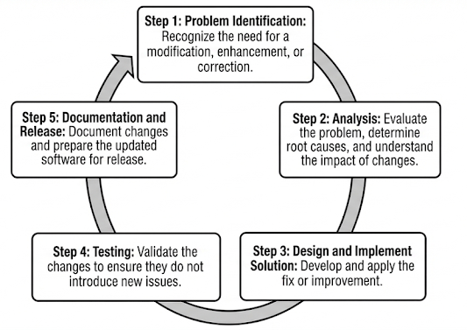
Maintenance Process and Best PRactices
Typical Maintenance PRocess
Best Practices
Code Documentation: Maintain clear and updated code documentation.
Version Control: Use version control systems (e.g., Git) to manage and track changes.
Automated Testing: Run automated tests to detect issues early and validate modifications.
Regular Refactoring: Continuously improve code quality to ease future maintenance.
User Feedback Collection: Regularly gather user input to prioritize improvements and address issues that impact user experience.

Slide 11
Challenges in software maintenance
Common Challenges
High Complexity: Legacy code and dependencies make changes difficult.
Inadequate Documentation: Lack of documentation can hinder understanding and increase time spent on changes.
Resource Constraints: Limited time, budget, and skilled personnel often impact maintenance quality.
Managing Technical Debt: Accumulated shortcuts or outdated code require attention but are often deferred.
Changing Requirements: Business or regulatory changes add complexity to ongoing maintenance.
Examples and Discussion:
Legacy Systems: Maintaining older systems with outdated technology is challenging, especially with limited compatibility with modern tools.
Technical Debt: Discuss how technical debt accumulates when quick fixes are prioritized over quality.

Slide 12
Measuring maintenance Effort and Effectiveness
Metrics for measuring maintenance Effort
Mean Time to Repair (MTTR): Average time taken to fix an issue.
Number of Outstanding Defects: Tracks unresolved defects over time to gauge system stability.
Defect Density: Number of defects per unit of code (e.g., per thousand lines of code).
Code Complexity Metrics: Measures such as cyclomatic complexity can indicate code maintainability.
User-Reported Issues: Tracking user-reported issues can highlight areas requiring more attention.

Slide 13
Measuring maintenance Effort and Effectiveness
Measuring effectiveness
User Satisfaction Surveys: Collect feedback on system usability and performance post-maintenance.
Regression Testing Pass Rate: High regression testing pass rates indicate that changes do not introduce new issues.
Maintenance Cost vs. Improvement: Analyze if the time and budget spent on maintenance achieve the intended improvements.

Slide 14
Metrics tell us how maintenance performs
but reality begins when we face the code we must change

Slide 15
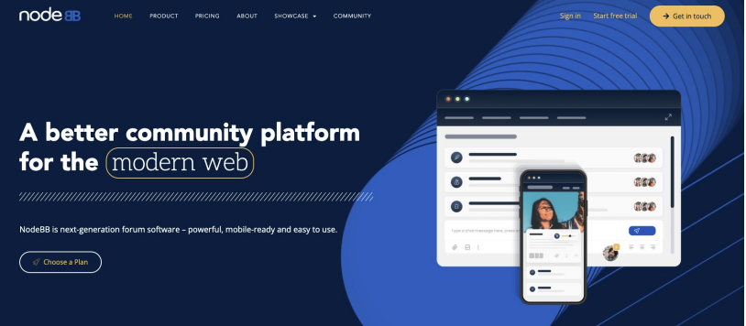
Preface
Context: big ole pile of Code
Do something with it!

Slide 16
You will never understand the entire system!

Slide 17
Challenge Regarding the system
How do I tackle this codebase?
Leverage your previous experiences (languages, technologies, patterns)
Consult documentation, whitepapers
Talk to experts, code owners
Follow best practices to build a working model of the system
But…

Slide 18

Challenge Regarding the system
Bad news: There are few helpful resources
Working Effectively with Legacy Code. Michael C. Feathers. 2004.
Re-Engineering Legacy Software. Chris Birchall. 2016.
The Legacy Code Programmer's Toolbox. Jonathan Boccara. 2019.

Slide 19
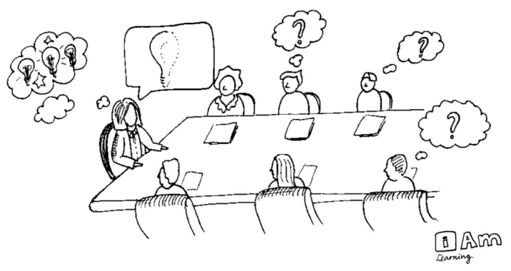
Challenge Regarding the system
Why?
Because of tacit knowledge
How does it become a problem? Discuss!

Slide 20
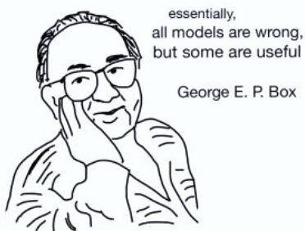
Challenge Regarding the system
Again, How to Tackle Codebases
Goal: develop and test a working model or set of working hypotheses about how (some part of) a system works
Working model: an understanding of the pieces of the system (components), and the way they interact (connections)
Focus: Observation, probes, and hypothesis testing
  Helpful tools and techniques!

Slide 21
Understanding a new Codebase
Steps to understand
Look at README.md
Clone the repo.
Build the codebase.
Figure out how to make it run.
What do you want to mess with?
  Clone and own
Traceability - Attach a debugger
  View Source
  Find the logs.
  Search for constants (strings, colors, weird integers (#DEADBEEF))

Slide 22
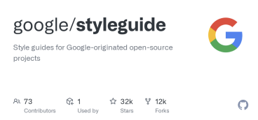
Observation
Software is full of Patterns
File structure
System architecture
Code structure
Names
…

Slide 23

Observation
Software is massively redundant
There’s always something to copy/use as a starting point!

Slide 24
Observation
Things to know
Code must run to do stuff!
If code runs, it must have a beginning…
If code runs, it must exist…

Slide 25
Observation
The Beginning: Entry Points
Locally installed programs: run cmd, OS launch, I/O events, etc.
Local applications in dev: build + run, test, deploy (e.g., docker)
Web apps server-side: Browser sends HTTP request (GET/POST)
Web apps client-side: Browser runs JavaScript, event handlers

Slide 26
Observation
Code must exist. But where?
Locally installed programs: run cmd, OS launch, I/O events, etc.
  Binaries (machine code) on your computer
Local applications in dev: build + run, test, deploy (e.g., docker)
  Source code in repository (+ dependencies)
Web apps server-side: Browser sends HTTP request (GET/POST)
  Code runs remotely (you can only observe outputs)
Web apps client-side: Browser runs JavaScript, event handlers
  Source code is downloaded and run locally (see: browser dev tools!)

Slide 27
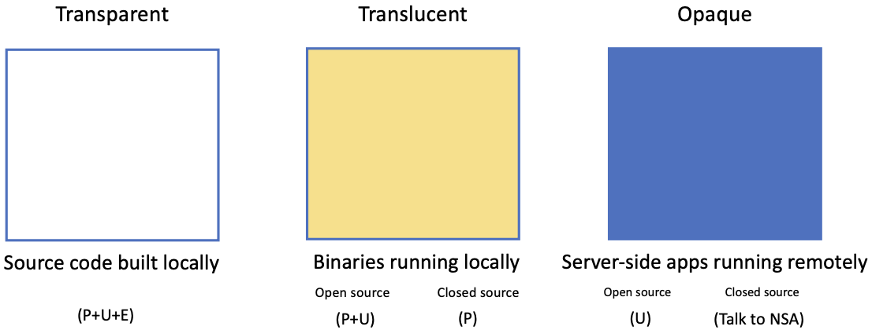
Observation
Can running code be probed/understood/edited?

Slide 28
Observation
Creating a Model of Unfamiliar Code
Understanding the Code: You start by reading and studying the code to grasp its functionality and how it's structured. This might involve examining the code line by line, understanding the logic, and identifying key components.
Documentation: As you understand the code, you create documentation that explains what different parts of the code do. This documentation can be in the form of comments in the code, separate documents, diagrams, or other formats. It's essential for making the code understandable to others and for future reference.
Reverse Engineering: If the code is particularly challenging, you may need to "reverse engineer" it, which involves deconstructing the code to understand its internal workings. This might include identifying algorithms, data structures, and dependencies.
Creating Mental Models: Throughout the process, you develop a mental model of how the code functions. This model helps you work with the code more effectively and make changes or improvements as needed.
Testing and Experimentation: As you work with unfamiliar code, you might run tests, make small changes, and experiment to confirm your understanding and validate your model. This is crucial to ensure that your understanding of the code is correct.
Overall, creating a model of unfamiliar code is an essential step in maintaining, extending, or fixing software systems. It helps developers and maintainers become familiar with the codebase, making it more manageable and allowing for improvements or bug fixes.

Slide 29
Information Gathering
Basic needs:
  Code/file search and navigation
  Code editing (probes)
  Execution of code, tests
  Observation of output (observation)
Many choices here on tools! Depends on circumstance.
  grep/find/etc. Knowing Unix tools is invaluable
  A decent IDE
  Debugger
  Test frameworks + coverage reports
  Google (or your favorite web search engine)
  ChatGPT or LaMA

Slide 30
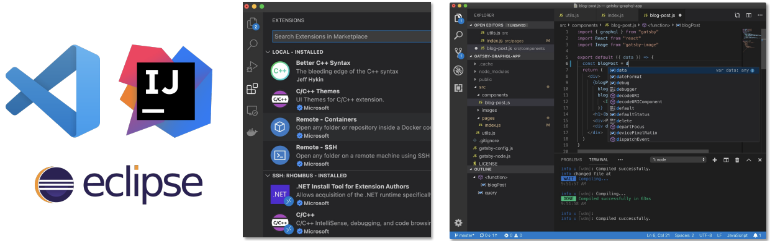
Information Gathering
Static information gathering
Use an IDE! Real software is too complex to keep in your head

Slide 31
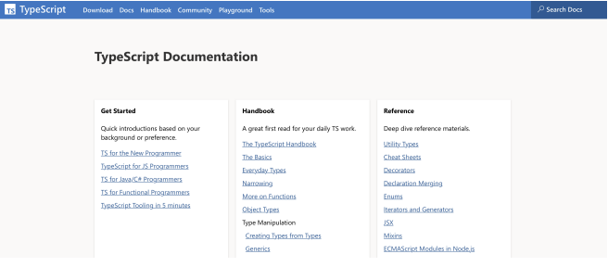
Information Gathering
Consider Documentation and Tutorials Judiciously
Great for discovering entry points!
Can teach you about general structure, architecture
Often out of date.
As you gain experience, you will recognize more of these, and you will immediately know something about how the program works
Also: discussion boards; issue trackers

Slide 32
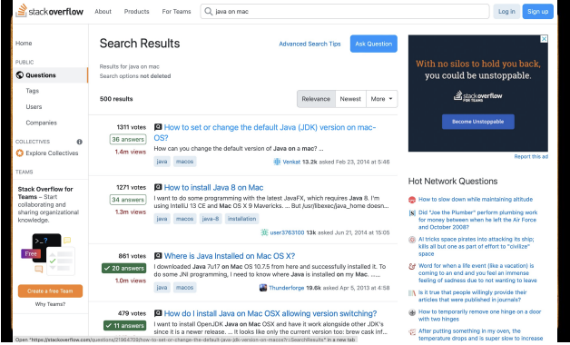
Information Gathering
Discussion Boards and Issue Trackers
Software is written by people.
How can we talk to them?
Fortunately, they probably aren’t dead.
So, you can report problems on GitHub.
Or, ask them questions on StackOverflow.

Slide 33

Information Gathering
Dynamic Information Gathering: Change helps to inform and refine mental models
Build it.
Run it.
Change it.
Run it again.
How did the behavior change?

Slide 34
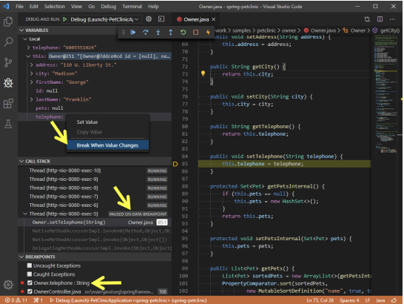
Information Gathering
Probes: Observe, Control or “LightLy” Manipulate Execution
print(“this code is running!”)
Structured logging
Debuggers
  Breakpoint, eval, step through / step over
  (Some tools even support remote debugging)
Delete debugging
Chrome Developer Tools

Slide 35
Information Gathering
Step 0: Sanity Check basic Model + Hypotheses
Confirm that you can build and run the code.
  Ideally both using the tests provided, and by hand.
Confirm that the code you are running is the code you built
Confirm that you can make an externally visible change
How? Where? Starting points:
  Run an existing test, change it
  Write a new test
  Change the code, write or rerun a test that should notice the change
Ask someone for help

Slide 36
Activity
Write down one pro and one con about trying to understand a new codebase by compiling and building it vs. just reading the code
Compare the answers with your friend. Do you agree?
Discuss furthermore!

Slide 37
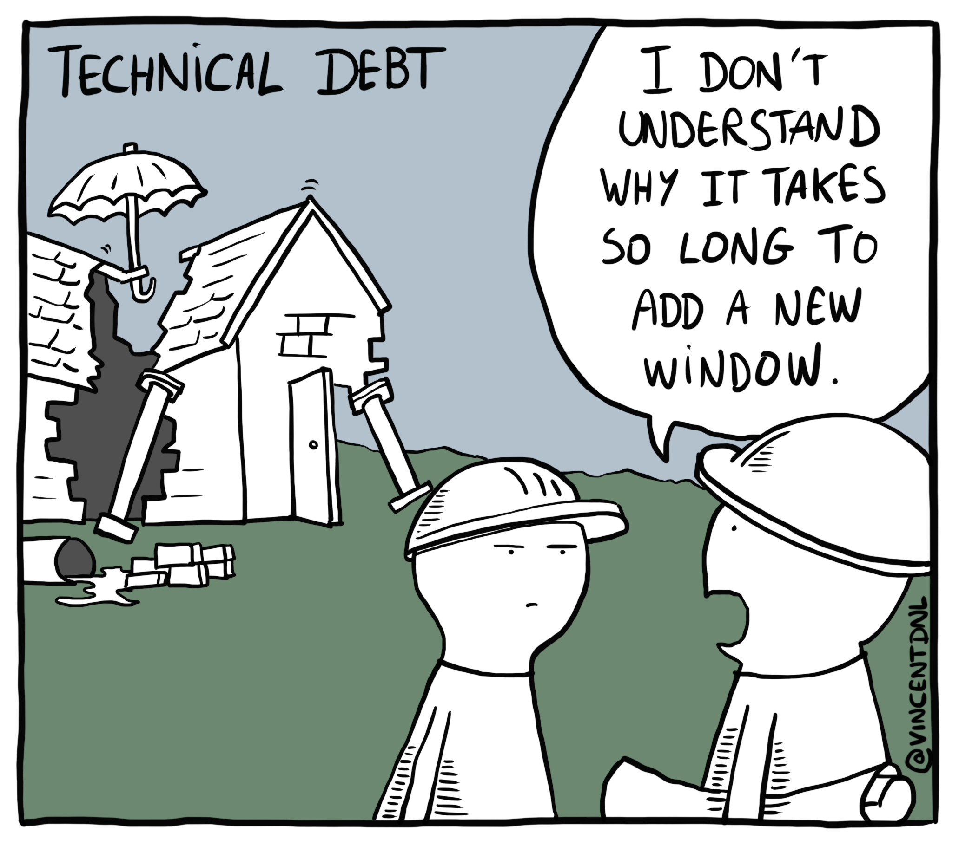
Understanding Technical Debt

Slide 38
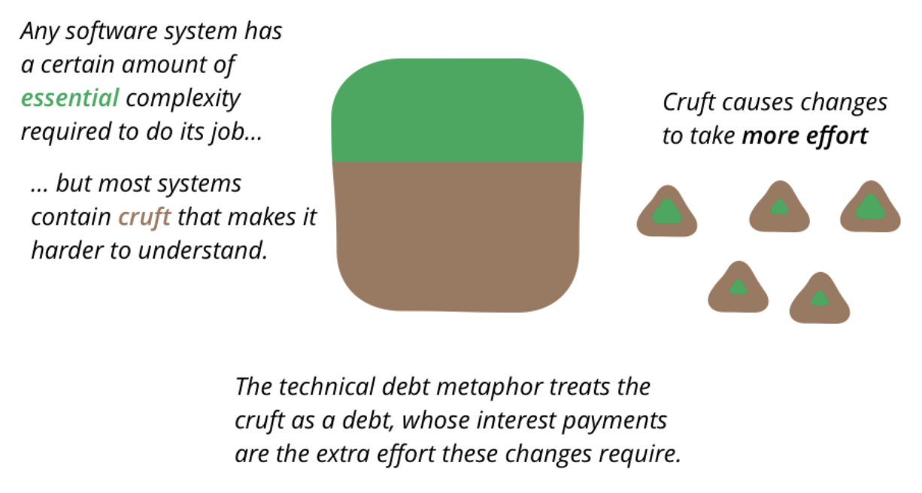
Understanding Technical Debt

Slide 39
Understanding Technical Debt
What is Technical Debt?
Technical debt is the cost of additional rework caused by taking shortcuts or choosing a simpler, less ideal solution in the short term that must be corrected later for the system to remain efficient and adaptable.
Example: A development team hardcodes values instead of creating a configuration file to save time but must revisit this approach for future scalability.

Slide 40
Understanding Technical Debt
TECHNICAL DEBT != BAD INTERNAL QUALITY
In software-intensive systems, technical debt consists of design or implementation constructs that are expedient in the short term but that set up a technical context that can make a future change more costly or impossible.
Technical debt is a contingent liability whose impact is limited to internal system qualities – primarily, but not only, maintainability and evolvability.

Slide 41
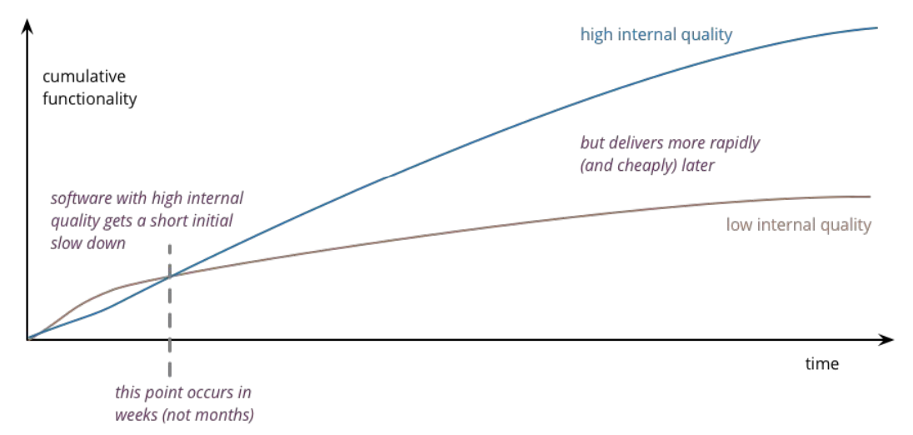
Understanding Technical Debt
HIGH INTERNAL QUALITY IS AN INVESTMENT

Slide 42
Understanding Technical Debt
WHAT ACTIONS CAUSE TECHNICAL DEBT?
Time Pressure: Shortcuts taken to meet deadlines, such as skipping tests or not refactoring.
Poor Documentation: Leads to misunderstandings, contributing to inefficient fixes and updates.
Lack of Standards: Inconsistent coding practices that accumulate over time.
Evolving Requirements: New features or requirements necessitate updates to existing code.
…

Slide 43

Understanding Technical Debt
BITROT: EVEN IF YOUR SOFTWARE DOESN’T CHANGE, IT WILL BREAK OVER TIME

Slide 44

Understanding Technical Debt
Everyone creates technical debt

Slide 45
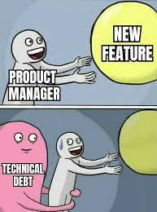
Understanding Technical Debt
Bad: Too much technical debt
Bad code can be demoralizing
Conversations with the client become awkward
Team infighting
Turnover and attrition
Development speed
…

Slide 46
Identifying and Prioritizing Technical Debt
Methods for Identifying Technical Debt
Code Reviews: Regular peer reviews can highlight areas needing refactoring.
Static Analysis Tools: Tools like SonarQube and CodeClimate assess code quality and detect technical debt.
Feedback from Developers: Developers often know which parts of the codebase are problematic.
Automated Metrics: Metrics like cyclomatic complexity, code duplication, and lack of test coverage signal debt.

Slide 47
Identifying and Prioritizing Technical Debt
Prioritizing Technical Debt
Severity and Impact: Prioritize debt with high impact on performance, security, or maintainability.
Risk vs. Reward: Assess which debts are worth addressing immediately and which can wait.
Business Value: Align technical debt reduction with high-impact features to ensure valuable improvements.

Slide 48
Strategies for Managing Technical Debt
Strategies for addressing Technical Debt
Continuous Refactoring: Integrate small refactoring tasks into daily development to gradually reduce debt.
Dedicated Debt Reduction Sprints: Allocate specific sprints for addressing accumulated debt.
Refactoring in Tandem with New Features: When working on related features, include debt reduction as part of the process.
Documenting Technical Debt: Create a debt register to document and track items for future resolution.
Proactive Debt Management:
Defining Coding Standards: Ensures code consistency and reduces the risk of new debt.
Encouraging Code Ownership: Developers who take responsibility for specific components are more likely to reduce debt.

Slide 49
Strategies for Managing Technical Debt
Principles of Technical Debt Management
Technical debt is a useful rhetorical concept for dialogue.
If you do not incur any form of interest, then you probably do not have actual technical debt.
All systems have technical debt.
Technical debt must trace to the system
Technical debt is not synonymous with bad quality.
Architecture technical debt has the highest cost of ownership.
All code matters!
Technical debt has no absolute measure.
Technical debt depends on the future evolution of the system.

Slide 50
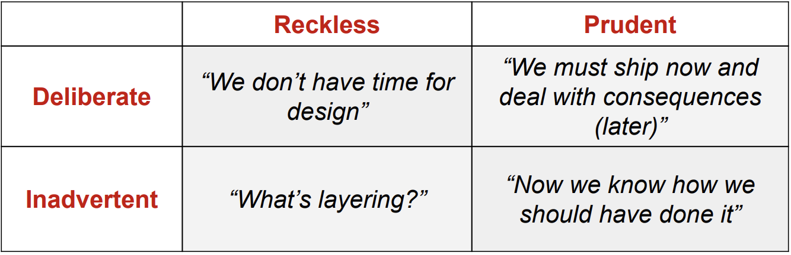
Strategies for Managing Technical Debt
Not All Technical Debt is the Same

Slide 51
Strategies for Managing Technical Debt
How Can We Avoid (Inadvertent) Technical Debt?
Common Anti-Patterns:
Not having a QA process! Or no-one follows it
Bad version control practices
  Everyone commits to the main branch
  Long-lived feature branches
  Huge PRs
Slow and encumbering QA processes
  Changes take forever to get merged
  Time could be better spent on new features
Reliance on repetitive manual labor
  focused on superficial problems rather than structural ones
  results may vary (e.g., manual testing)
  mistakes will happen!

Slide 52
Refactoring Techniques
Refactoring
Refactoring is the process of improving code structure without changing its external behavior, making it easier to read, maintain, and extend.
Common Refactoring Techniques:
Extract Method: Moves a code block into a separate method, improving readability and reuse.
  Example: Extracting code from a long function into smaller, named methods to clarify functionality.
Rename Variable: Gives variables meaningful names to enhance readability and maintainability.
  Example: Renaming temp to averageTemperature for clarity.
Simplify Conditionals: Reduces complexity in conditional statements, often by using guard clauses or combining conditions.
  Example: Converting nested if statements into simpler expressions or separate methods.
When to Refactor: When adding new features, fixing bugs, or reviewing code for potential improvements.

Slide 53
References
Pressman, R.S. (2015). Software Engineering : A Practioner's Approach. 8th ed. McGraw-Hill Companies.Inc, Americas, New York. ISBN : 978 1 259 253157.
Risk Management & operational Risk http://www.grafp.com/products/risk-manage.html
Sw maintenance and Reengineering http://www.csse.monash.edu.au/~jonmc/CSE2305/Topics/13.25.SWEng4/html/text.html

